Slide 1
Time Synchronization and Logical Clocks
CS 240: Computing Systems and Concurrency
Lecture 5
Mootaz Elnozahy
Credits: Michael Freedman and Kyle Jamieson developed much of the original material.

Slide 2
Today
The need for time synchronization
“Wall clock time” synchronization
Logical Time
Notes:
Today we’ll begin with why we need time synchronization in distributed systems, then look at algorithms for time synchronization in the wall clock time sense, and for distributed systems we’ll see shortcomings there. Finally we’ll discuss Logical Time, which overcomes these shortcomings.

Slide 3
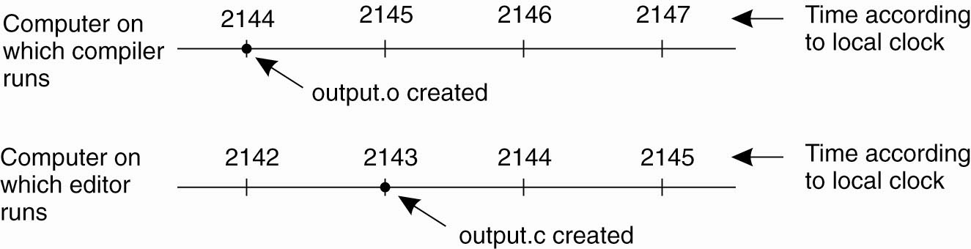
A distributed edit-compile workflow
Physical time →
2143 < 2144 ➔ make doesn’t call compiler
Lack of time synchronization result – a possible object file mismatch
Notes:
Consider a distributed edit-compile workflow where a user’s laptop computer runs an editor and a server runs make/compiler over a shared filesystem like NFS.
make examines file modification times, tests whether source file time > object file.
Should call compiler b/c file edited after a compile.

Slide 4
What makes time synchronization hard?
Quartz oscillator sensitive to temperature, age, vibration, radiation
Accuracy ca. one part per million (one second of clock drift over 12 days)
The internet is:
Asynchronous: arbitrary message delays
Best-effort: messages don’t always arrive
Notes:
Is it possible to synchronize all the clocks in a distributed system?

Slide 5
Today
The need for time synchronization
“Wall clock time” synchronization
Cristian’s algorithm, Berkeley algorithm, NTP
Logical Time
Lamport clocks
Vector clocks
Notes:
Let’s look at some time synchronization techniques that use software algorithms to overcome this problem and get distributed time synchronization. Then after that we’re going to see where these techniques limitations lead us to logical time.

Slide 6
Just use Coordinated Universal Time?
UTC is broadcast from radio stations on land and satellite (e.g., the Global Positioning System)
Computers with receivers can synchronize their clocks with these timing signals
Signals from land-based stations are accurate to about 0.1−10 milliseconds
Signals from GPS are accurate to about one microsecond
Why can’t we put GPS receivers on all our computers?
Notes:
Since it’s so accurate, let’s think about whether we could use UTC to synchronize all the computers in a distributed system
GPS does not work inside buildings
GPS is power hungry

Slide 7


Synchronization to a time server
Suppose a server with an accurate clock (e.g., GPS-disciplined crystal oscillator)
Could simply issue an RPC to obtain the time:
But this doesn’t account for network latency
Message delays will have outdated server’s answer
Client
Server
Time of day?
2:50 PM
Time ↓
Notes:
So let's think about techniques for time synchronization using the network.
Neither of the two knows how long the Internet took to delay the message

Slide 8
Cristian’s algorithm: Outline
Client sends a request packet, timestamped with its local clock T₁
Server timestamps its receipt of the request T₂ with its local clock
Server sends a response packet with its local clock T₃ and T₂
Client locally timestamps its receipt of the server’s response T₄
Client
Server
T₁
request:
T₁
T₂
T₃
T₄
T₂,T₃
response:
How the client can use these timestamps to synchronize its local clock to the server’s local clock?
Time ↓
Notes:
Let's look at an algorithm to calculate and compensate for these message delays.
SEGUE: Okay, so how will the client use these timestamps to synchronize its local clock to the server’s local clock?

Slide 9
Cristian’s algorithm: Offset sample calculation
Client
Server
Goal: Client sets clock ← T₃ + 𝛿_{resp}
Client samples round trip time 𝛿 = 𝛿_{req} + 𝛿_{resp} = (T₄ − T₁) − (T₃ − T₂)
But client knows 𝛿, not 𝛿_{resp}
T₁
request:
T₁
𝛿_{req}
T₂
𝛿_{resp}
T₃
Assume: 𝛿_{req} ≈ 𝛿_{resp}
T₄
T₂,T₃
response:
Client sets clock ← T₃ + ½𝛿
Time ↓
Notes:
The goal is that at *this* point in time, the client set its clock to T3 + delta_{resp}
Delta = (T4-T1)-(T3-T2): The client has all these values available from these four timestamps.

Slide 10
Today
The need for time synchronization
“Wall clock time” synchronization
Cristian’s algorithm, Berkeley algorithm, NTP
Logical Time
Lamport clocks
Vector clocks
Notes:
Christian's algorithm is a building block. Two useful wall clock time synchronization algorithms...

Slide 11
Berkeley algorithm
A single time server can fail, blocking timekeeping
The Berkeley algorithm is a distributed algorithm for timekeeping
Assumes all machines have equally-accurate local clocks
Obtains average from participating computers and synchronizes clocks to that average

Slide 12
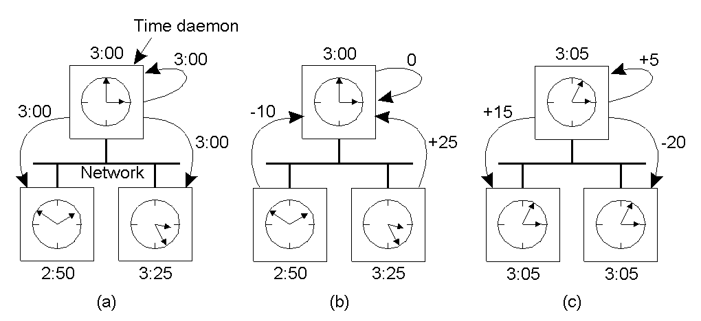
Berkeley algorithm
Master machine: polls L other machines using Cristian’s algorithm → { 𝜃_{i} } (i = 1…L)
Master
Notes:
Master computes average offset 𝜃_{ave}, tells others to adjust their clock by 𝜃_{ave} − 𝜃_{i}
Average clock offset = + 5 minutes
What if the master fails? Elect a new master to take over (more on this later)

Slide 13
Today
The need for time synchronization
“Wall clock time” synchronization
Cristian’s algorithm, Berkeley algorithm, NTP
Logical Time
Lamport clocks
Vector clocks
Notes:
Finally NTP -- most commonly deployed on the Internet.

Slide 14
The Network Time Protocol (NTP)
Enables clients to be accurately synchronized to UTC despite message delays
Provides reliable service
Survives lengthy losses of connectivity
Communicates over redundant network paths
Provides an accurate service
Unlike the Berkeley algorithm, leverages heterogeneous accuracy in clocks

Slide 15
NTP: System structure
Servers and time sources are arranged in layers (strata)
Stratum 0: High-precision time sources themselves
e.g., atomic clocks, shortwave radio time receivers
Stratum 1: NTP servers directly connected to Stratum 0
Stratum 2: NTP servers that synchronize with Stratum 1
Stratum 2 servers are clients of Stratum 1 servers
Stratum 3: NTP servers that synchronize with Stratum 2
Stratum 3 servers are clients of Stratum 2 servers
Users’ computers synchronize with Stratum 3 servers

Slide 16
NTP operation: Server selection
Messages between an NTP client and server are exchanged in pairs: request and response
Use Cristian’s algorithm
For i^{th} message exchange with a particular server, calculate:
Clock offset 𝜃_{i} from client to server
Round trip time 𝛿_{i} between client and server
Over last eight exchanges with server k, the client computes its dispersion 𝜎_{k} = max_{i} 𝛿_{i} − min_{i} 𝛿_{i}
Client uses the server with minimum dispersion
Notes:
To get redundancy in network paths, server selection.

Slide 17
NTP operation : Clock offset calculation
Client tracks minimum round trip time and associated offset over the last eight message exchanges (𝛿₀, 𝜃₀)
𝜃₀ is the best estimate of offset: client adjusts its clock by 𝜃₀ to synchronize to server
Offset 𝜃
Each point represents one sample
𝜃₀
𝛿₀
Round trip time 𝛿
Notes:
Additional RTT delay add to either the outbound delay or inbound delay, but recall that Cristian's algorithm used only one sided delay. So potential inaccuracy is half the additional RTT delay.

Slide 18
NTP operation: How to change time
Can’t just change time: Don’t want time to run backwards
Recall the make example
Instead, change the update rate for the clock
Changes time in a more gradual fashion
Prevents inconsistent local timestamps

Slide 19
Clock synchronization: Take-away points
Clocks on different systems will always behave differently
Disagreement between machines can result in undesirable behavior
NTP, Berkeley clock synchronization
Rely on timestamps to estimate network delays
100s 𝝁s−ms accuracy
Clocks never exactly synchronized
Often inadequate for distributed systems
Often need to reason about the order of events
Might need precision on the order of ns

Slide 20
Today
The need for time synchronization
“Wall clock time” synchronization
Cristian’s algorithm, Berkeley algorithm, NTP
Logical Time
Lamport clocks
Vector clocks

Slide 21
Motivation: Multi-site database replication
A New York-based bank wants to make its transaction ledger database resilient to whole-site failures
Replicate the database, keep one copy in sf, one in nyc
San Francisco
New York
Notes:
Whole-site failure: Flood, fire, disaster

Slide 22
The consequences of concurrent updates
Replicate the database, keep one copy in sf, one in nyc
Client sends query to the nearest copy
Client sends update to both copies
Inconsistent replicas!
Updates should have been performed in the same order at each copy
“Deposit
$100”
$1,000
$1,000
$1,010
$1,100
$1,110
$1,111
“Pay 1%
interest”
Notes:
What’s the simplest way of replicating the database?
Query to nearest means that speed increases – good!
Updates are forwarded to each – let’s see the consequences…

Slide 23
Idea: Logical clocks
Landmark 1978 paper by Leslie Lamport
Insight: only the events themselves matter
Idea: Disregard the precise clock time
Instead, capture just a “happens before” relationship between a pair of events

Slide 24
Defining “happens-before”
Consider three processes: P1, P2, and P3
Notation: Event a happens before event b (a → b)
P1
P2
P3
Physical time ↓
Notes:
How do we capture the happens-before relationship?

Slide 25
Defining “happens-before”
Can observe event order at a single process
P1
P2
P3
a
b
Physical time ↓
Notes:
So let's reason about what happens before ought to mean.

Slide 26
Defining “happens-before”
If same process and a occurs before b, then a → b
P1
P2
P3
a
b
Physical time ↓

Slide 27
Defining “happens-before”
If same process and a occurs before b, then a → b
Can observe ordering when processes communicate
P1
P2
P3
a
b
c
Physical time ↓
Notes:
Continuing to reason about happens before.
P1 is sending a message – any message to P2.
Event b is the message transmission
Event c is the message reception.

Slide 28
Defining “happens-before”
If same process and a occurs before b, then a → b
If c is a message receipt of b, then b → c
P1
P2
P3
a
b
c
Physical time ↓

Slide 29
Defining “happens-before”
If same process and a occurs before b, then a → b
If c is a message receipt of b, then b → c
Can observe ordering transitively
P1
P2
P3
a
b
c
Physical time ↓

Slide 30
Defining “happens-before”
If same process and a occurs before b, then a → b
If c is a message receipt of b, then b → c
If a → b and b → c, then a → c
P1
P2
P3
a
b
c
Physical time ↓
Notes:
SEGUE: So you can begin to see the power of Lamport clocks.

Slide 31
Concurrent events
Not all events are related by →
a, d not related by → so concurrent, written as a || d
P1
P2
P3
a
d
b
c
Physical time ↓
Notes:
Consider events a and d: different processes and no chain of messages relates them

Slide 32
Lamport clocks: Objective
We seek a clock time C(a) for every event a
Clock condition: If a → b, then C(a) < C(b)
Plan: Tag events with clock times; use clock times to make distributed system correct
Notes:
So thinking back to our distributed bank ledger example, our plan now is to define a clock time for every event.

Slide 33
The Lamport Clock algorithm
Each process P_{i} maintains a local clock C_{i}
Before executing an event, C_{i} ← C_{i} + 1
P1
C₁=0
P2
C₂=0
P3
C₃=0
a
b
c
Physical time ↓
Notes:
Each process will maintain an integer-valued local clock (not a wall clock time)

Slide 34
The Lamport Clock algorithm
Before executing an event a, C_{i} ← C_{i} + 1:
Set event time C(a) ← C_{i}
P1
C₁=1
P2
C₂=1
P3
C₃=1
C(a) = 1
a
b
c
Physical time ↓

Slide 35
The Lamport Clock algorithm
Before executing an event b, C_{i} ← C_{i} + 1:
Set event time C(b) ← C_{i}
P1
C₁=2
P2
C₂=1
P3
C₃=1
C(a) = 1
a
C(b) = 2
b
c
Physical time ↓

Slide 36
The Lamport Clock algorithm
Before executing an event b, C_{i} ← C_{i} + 1
Send the local clock in the message m
P1
C₁=2
P2
C₂=1
P3
C₃=1
C(a) = 1
a
C(b) = 2
b
c
Physical time ↓
C(m) = 2

Slide 37
The Lamport Clock algorithm
On process P_{j} receiving a message m:
Set C_{j} and receive event time C(c) ←1 + max{ C_{j}, C(m) }
P1
C₁=2
P2
C₂=3
P3
C₃=1
C(a) = 1
a
C(b) = 2
C(c) = 3
b
c
Physical time ↓
C(m) = 2

Slide 38
Ordering all events
Break ties by appending the process number to each event:
Process P_{i} timestamps event e with C_{i}(e).i
C(a).i < C(b).j when:
C(a) < C(b), or C(a) = C(b) and i < j
Now, for any two events a and b, C(a) < C(b) or C(b) < C(a)
This is called a total ordering of events

Slide 39
Making concurrent updates consistent
P2
P1
Recall multi-site database replication:
San Francisco (P1) deposited $100:
New York (P2) paid 1% interest:
$
%
We reached an inconsistent state
Could we design a system that uses Lamport Clock total order to make multi-site updates consistent?

Slide 40
Totally-Ordered Multicast
Client sends update to one replica → Lamport timestamp C(x)
Key idea: Place events into a local queue
Sorted by increasing C(x)
P1’s local
queue:
1.1
1.2
P2’s local
queue:
1.2
$
%
%
P1
P2
Goal: All sites apply the updates in (the same) Lamport clock order
Notes:
Protocol I'll show you that does this is called Totally-Ordered Multicast.
SEGUE: Processes’ queues can differ. So they need to tell each other about their events – let’s see how this happens.

Slide 41
Totally-Ordered Multicast ^{(Almost correct)}
On receiving an event from client, broadcast to others (including yourself)
On receiving an event from replica:
Add it to your local queue
Broadcast an acknowledgement message to every process (including yourself)
On receiving an acknowledgement:
Mark corresponding event acknowledged in your queue
Remove and process events everyone has ack’ed from head of queue
Notes:
Key idea: Exchange messages to agree on the contents of everyone’s queue.

Slide 42
Totally-Ordered Multicast (Almost correct)
1.1
P1 queues $, P2 queues %
P1 queues and ack’s %
P1 marks % fully ack’ed
P2 marks % fully ack’ed
1.1
1.2
1.2
%
$
%
$
✔
✔
✔
✔
P2
P1
1.1
1.2
$
%
ack
%
%
P2 processes %
(Ack’s to self not shown here)
Notes:
Want it to be the case that both replicas process 1.1 before 1.2.
P1 marks % fully acked: P1 has received its own ack and P2’s ack for the 10% interest update which is not shown and comes with the original update from P2. Does P1 go ahead and process the 10% interest? No – it processes updates in order. So far so good?
P2 marks % full acked: P2 has received its own ack and P1’s ack for the 10% interest update. Now P2 processes the 10% interest update, since it doesn’t yet know about the deposit! Uh oh!
P1 marks $ fully acked: Now P1 can go ahead and processes both updates in order.
Where did we go wrong??? Well P2 couldn’t possibly have known about the deposit at this point. But got an ack from P1 because P1 sent its ack out of order which allowed it to process out of order.

Slide 43
Totally-Ordered Multicast ^{(Correct version)}
On receiving an event from client, broadcast to others (including yourself)
On receiving or processing an event:
Add it to your local queue
Broadcast an acknowledgement message to every process (including yourself) only from head of queue
When you receive an acknowledgement:
Mark corresponding event acknowledged in your queue
Remove and process events everyone has ack’ed from head of queue
Notes:
So we want P1 to help to enforce this ordering by being more careful about the order in which we send the acknowledgement messages.

Slide 44
Totally-Ordered Multicast ^{(Correct version)}
1.1
1.2
1.1
1.2
$
%
$
%
✔
✔
✔
✔
P2
P1
1.1
1.2
$
%
ack
$
$
$
ack
%
%
%
(Ack’s to self not shown here)
Notes:
P1 queues %: Does P1 ack P2’s update yet? No! By our modification, P1 will only ack updates at the head of the queue. So it waits, and waits, and waits…
P1 processes $: Now P2’s update moves to the head of the queue and P1 can ack it, both to itself and P2.
P1 marks % fully acked: It has gotten its own ack and P2’s ack for the 10% interest update (not shown)
Does P1 go ahead and process the 10% interest? No – it processes in order.

Slide 45
So, are we done?
Does totally-ordered multicast solve the problem of multi-site replication in general?
Not by a long shot!
Our protocol assumed:
No node failures
No message loss
No message corruption
All to all communication does not scale
Waits forever for message delays (performance?)
Notes:
Suppose we’re the customer, the bank, who wants to replicate its database. Are we happy?

Slide 46
Take-away points: Lamport clocks
Can totally-order events in a distributed system: that’s useful!
But: while by construction, a → b implies C(a) < C(b),
The converse is not necessarily true:
C(a) < C(b) does not imply a → b (possibly, a || b)
Can’t use Lamport clock timestamps to infer causal relationships between events
Notes:
Want to tag events with logical timestamps and reason about their causal or happens-before relationships, but can’t use Lamport clock timestamps here
And this is what we will want to do later in the class when we build systems that process updates in a distributed manner.

Slide 47
Today
The need for time synchronization
“Wall clock time” synchronization
Cristian’s algorithm, Berkeley algorithm, NTP
Logical Time
Lamport clocks
Vector clocks

Slide 48
Vector clock (VC)
Label each event e with a vector V(e) = [c₁, c₂ …, c_{n}]
c_{i} is a count of events in process i that causally precede e
Initially, all vectors are [0, 0, …, 0]
Two update rules:
For each local event on process i, increment local entry c_{i}
If process j receives message with vector [d₁, d₂, …, d_{n}]:
Set each local entry c_{k} = max{c_{k}, d_{k}}
Increment local entry c_{j}
Notes:
Suppose we have n processes.
From the viewpoint of a particular process.

Slide 49
Vector clock: Example
All counters start at [0, 0, 0]
Applying local update rule
Applying message rule
Local vector clock piggybacks on inter-process messages
P1
P2
P3
a
[1,0,0]
e
[0,0,1]
[2,0,0]
b
[2,0,0]
[2,1,0]
c
[2,2,0]
d
[2,2,0]
[2,2,2]
f
Physical time ↓
Notes:
[2,2,2]: Remember we have event e at P3 with timestamp [0,0,1]. D’s message gets timestamp [2,2,0], we take max to get [2,2,1] then increment the local entry to get [2,2,2].

Slide 50
Vector clocks can establish causality
Rule for comparing vector clocks:
V(a) = V(b) when a_{k} = b_{k} for all k
V(a) < V(b) when a_{k} ≤ b_{k} for all k and V(a) ≠ V(b)
Concurrency: a || b if a_{i} < b_{i} and a_{j} > b_{j}, some i, j
V(a) < V(z) when there is a chain of events linked by → between a and z
a
[1,0,0]
[2,0,0]
b
[2,1,0]
c
z
[2,2,0]

Slide 51
Two events a, z
Lamport clocks: C(a) < C(z)
Conclusion: None
Vector clocks: V(a) < V(z)
Conclusion: a → … → z
Vector clock timestamps tell us about causal event relationships
Notes:
There is a chain of events that leads from a to z in the distributed system!

Slide 52
VC application: Causally-ordered bulletin board system
Distributed bulletin board application
Each post → multicast of the post to all other users
Want: No user to see a reply before the corresponding original message post
Deliver message only after all messages that causally precede it have been delivered
Otherwise, the user would see a reply to a message they could not find
Notes:
Users post messages, reply to each others’ messages.

Slide 53
VC application: Causally-ordered bulletin board system
Original
post
1’s reply
Physical time →
User 0 posts, user 1 replies to 0’s post; user 2 observes
Notes:
>>> So P₂ can detect a missing message based on its vector clock.
SEGUE: So we have this encoding of other processes' actions in the vector clock that lets P₂ make the right choice.

Slide 54
Wednesday Topic:
Lab 1 – Virtualization, sockets, RPCs

Slide 55
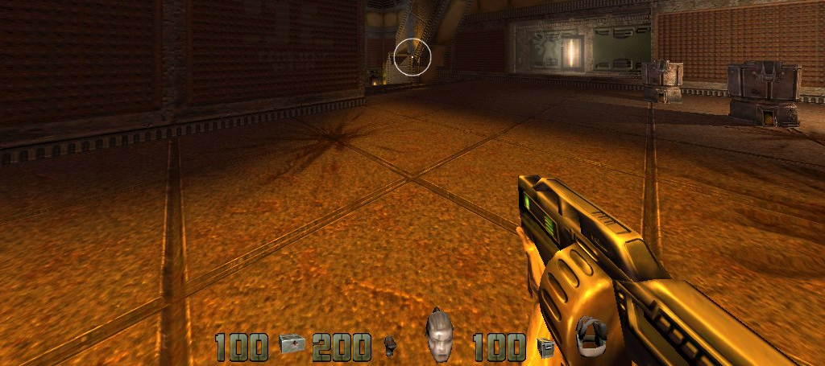
Why global timing?
Suppose there were an infinitely-precise and globally consistent time standard
That would be very handy. For example:
Who got last seat on airplane?
Mobile cloud gaming: Which was first, A shoots B or vice-versa?
Does this file need to be recompiled?
Notes:
Say I’m the designer of a distributed booking reservations system.
Say I’m the designer of a networked multi-player first person shooter video game.
Say I’m building a distributed compiler system.

Slide 56
Totally-Ordered Multicast ^{(Attempt #1)}
1.1
P1 queues $, P2 queues %
P1 queues and ack’s %
P1 marks % fully ack’ed
P2 marks % fully ack’ed
P2 processes %
P2 queues and ack’s $
P2 processes $
P1 marks $ fully ack’ed
P1 processes $, then %
1.1
1.2
1.2
%
$
%
$
✔
✔
✔
✔
P2
P1
1.1
1.2
$
%
ack
%
%
ack
$
$
$
%
Note: ack’s to self not shown here
Notes:
P1 marks % fully acked: P1 has received its own ack and P2’s ack for the 10% interest update which is not shown and comes with the original update from P2. Does P1 go ahead and process the 10% interest? No – it processes updates in order. So far so good?
P2 marks % full acked: P2 has received its own ack and P1’s ack for the 10% interest update. Now P2 processes the 10% interest update, since it doesn’t yet know about the deposit! Uh oh!
P1 marks $ fully acked: Now P1 can go ahead and processes both updates in order.
Where did we go wrong??? Well P2 couldn’t possibly have known about the deposit at this point. But got an ack from P1 because P1 sent its ack out of order which allowed it to process out of order.

Slide 57
Totally-Ordered Multicast ^{(Correct version)}
1.1
1.2
1.1
P1 queues $, P2 queues %
P1 queues %
P2 queues and ack’s $
P2 marks $ fully ack’ed
P2 processes $
P1 marks $ fully ack’ed
P1 processes $
P1 ack’s %
P1 marks % fully ack’ed
P1 processes %
P2 marks % fully ack’ed
P2 processes %
1.2
$
%
$
%
✔
✔
✔
✔
P2
P1
1.1
1.2
$
%
ack
$
$
$
ack
%
%
%
(Ack’s to self not shown here)
Notes:
P1 queues %: Does P1 ack P2’s update yet? No! By our modification, P1 will only ack updates at the head of the queue. So it waits, and waits, and waits…
P1 processes $: Now P2’s update moves to the head of the queue and P1 can ack it, both to itself and P2.
P1 marks % fully acked: It has gotten its own ack and P2’s ack for the 10% interest update (not shown)
Does P1 go ahead and process the 10% interest? No – it processes in order.

Slide 58
Time standards
Universal Time (UT1)
In concept, based on astronomical observation of the sun at 0º longitude
Known as “Greenwich Mean Time”
International Atomic Time (TAI)
Beginning of TAI is midnight on January 1, 1958
Each second is 9,192,631,770 cycles of radiation emitted by a Cesium atom
Has diverged from UT1 due to slowing of earth’s rotation
Coordinated Universal Time (UTC)
TAI + leap seconds, to be within 0.9 seconds of UT1
Currently TAI − UTC = 36
Notes:
UT1: began in 1884 based on observations of the sun at the Royal Observatory in Greenwich, England, but we now know that the period of the Earth’s rotation is not exactly constant.
TAI: Started after the invention of the atomic clock.
UTC: Currently we have added 36 leap seconds, the most recent on June 30 of last year.

Slide 59
VC application: Order processing
Suppose we are running a distributed order processing system
Each process = a different user
Each event = an order
A user has seen all orders with V(order) < the user’s current vector
Notes:
Let's look at how VCs can benefit a distributed order processing system.

